Slide 1

WIS 2.0 Training Workshop, Windhoek, Namibia, 20-24 March 2023​
CSV to BUFR
Enrico Fucile
Head, Data and Information Management Division

Slide 2
CSV2BUFR Key Ingredients
Data CSV file
Mappings JSON file
csv2bufr
BUFR file(s)

Slide 3
The Mappings File
This file allows csv2bufr to map the CSV column headers to their corresponding ecCodes key used by BUFR.
It also allows for unit conversion and range-based quality control checks.
The mappings file is also used in synop2bufr, but is pre-configured specifically for SYNOP reports.

Slide 4
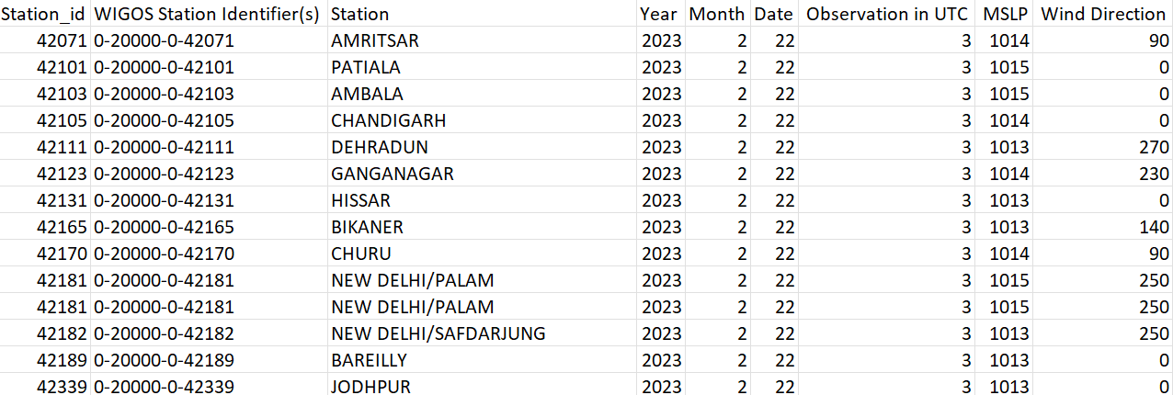
Example CSV File

Slide 5
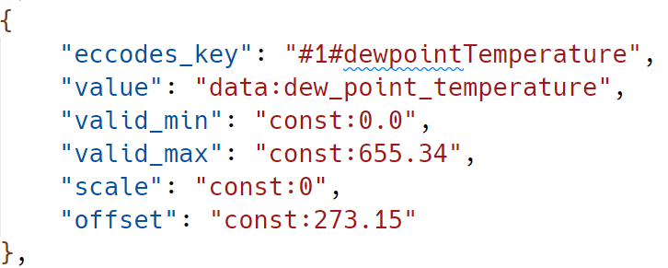
Mappings Creation and Example
csv2bufr mappings create 012003
ecCodes key
CSV column header
Minimum tolerable value
Maximum tolerable value
No re-scale factor (Celsius → Kelvin)
Shift factor (Celsius → Kelvin)

Slide 6
Conversion Command
csv2bufr data transform
--bufr-template <mapping JSON file>
--output-dir <output location>
<CSV data file>

Slide 7
Thank you
Merci

